Slide 1
Should SAF Update Their 1980 Book
Forest Cover Types of North America?
Richard W. Guldin, Guldin Forestry LLC
Notes:
Good morning. I’m Rich Guldin, a consulting forester working at the interface of science and policy.
I’ve been an SAF member for over 50 years. SAF has been a cornerstone of my professional training and career development.
I’m speaking today about a topic near and dear to me—providing up-to-date science to university students and field foresters. We are at a fork in the road—which path forward should we take? I’m focusing on why SAF should revise and update its book, Forest Cover Types of North America.

Slide 2
Bottom Line Up Front
The Silvics Manual & SAF Forest Cover Types are outdated
Revising them simultaneously would integrate their content from species to type ranges. That’s both sensible & cost-efficient
Revising them would clearly demonstrates leadership & commitment by FS R&D & SAF to field professionals & students
What do YOU think about revising them?
Notes:
Here’s my bottom line, up front.
Both books are seriously out-of-date. SAF’s is 40 years old, the Silvics Manual is 30 years old. Fresh science since the 1980s and 1990s limit the value of the current books for field foresters and students today. However, demand for the books still exists today—measured by downloads and SAF book sales.
Embarking on both revisions simultaneously makes the most sense and would be the most cost-efficient approach. Revising both would integrate their content—silvics of individual species affects species ranges, and species ranges affects the ranges of forest cover types.
Committing to revising now would demonstrate leadership and commitment by both the Forest Service and SAF. Commitment to supporting field professionals & students with an up-to-date set of e-tools; and a commitment to using state-of-the-art scientific information about tree species silvics and cover types to help public agencies and others practice ecosystem management.
I strongly believe they both need to be updated. But after my remarks, YOU will have an opportunity to share your thoughts with us.

Slide 3
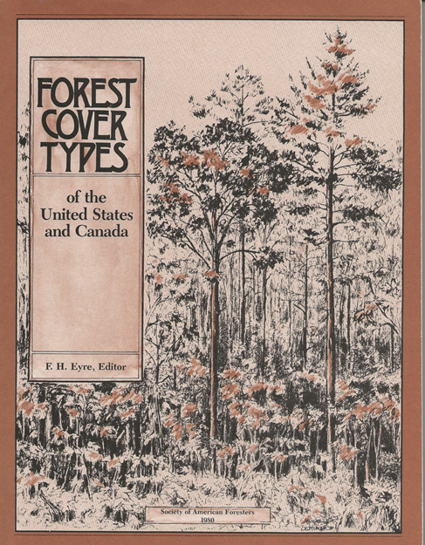
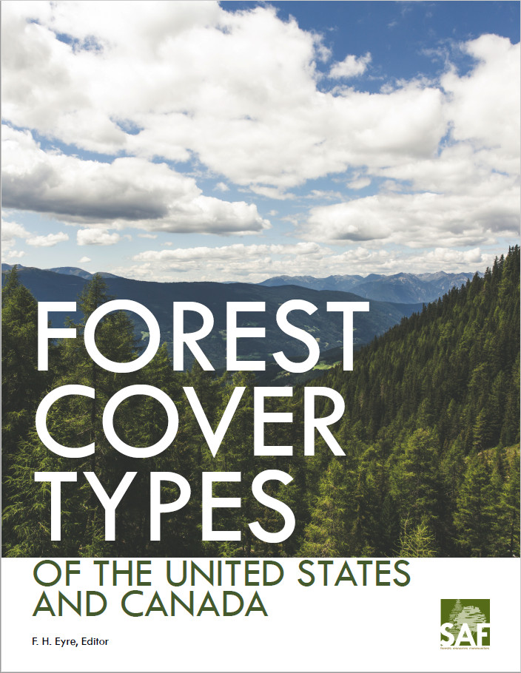
Background
1929: Ralph Hawley chaired an SAF committee that began classifying forest cover types for the eastern U.S. Published in 1940. Since then, there have been 3 major additions/revision
  1945: Added western U.S. forest cover types
  1954: Combined eastern & western types; plus Canadian types
  1980: Revisions included:
    Brief descriptions of ecological relationships & undergrowth species
    1967 map from U.S. National Atlas
SAF reprinted the 1980 book in 2017 with a new cover, but didn’t revise any of the content
Covers: 1980 2017 Cover
Notes:
SAF had been a leader in defining forest cover types during the 20th Century. SAF’s interest in the issue began early in its life. During the 1930s to 1970s, there was great interest in developing consistent definitions and terminology for forest cover types.
What is a forest cover type? A classification label that describes the composition of a forest’s vegetation, particularly it’s dominant or most abundant vegetation. Forest cover types depend on environmental factors where the stands of trees exist. Those factors include the soils, climate, and silvics of the component species. Forest cover type also includes anthropogenic factors—where have humans influenced the development of stands through reforestation and management activities.
You might see a copy with a new cover. SAF reprinted the 1980 book with a new cover—but didn’t revise any of the content from 1980!

Slide 4
Why Should SAF Revise Its Book?
The science is out-of-date
  Should a professional society that advocates using the best science continue to sell a 40-year-old book as a current scientific reference?
Forest Service R&D is considering whether to revise the 1990-vintage, two-volume “Silvics of North America”
  Some information is common to both
  Silvics are affected by ecological relationships, as are cover types
  Tree species ranges affect forest cover type ranges, etc.
The policy environment for classifying vegetation types has changed
Notes:
There are three major reasons why I think SAF should move forward to revise the 1980 edition of its book.
1980 science is woefully out-of-date. Should a professional society that advocates using the best science to manage America’s forests continue to sell a 40-year-old reference book? For actual usage on-the-ground, and not as a historical document?
Second, Forest Service R&D is considering whether to revise its 1990 vintage, two-volume Silvics of North America. Some of the detailed silvics information from 1990 was common to both the silvics volumes and the forest cover types book. Tree species ranges are inextricably linked to the ranges of forest cover types. Revising one without the other creates a disconnect that makes no sense.
Third, the policy environment for classifying vegetation types has changed. During the 1990s, Forest Service policy shifted to begin practicing ecosystem management, and the Federal Geographic Data Committee—a high-level interagency committee—developed a National Vegetation Classification Standard for all types of vegetation.
These are the three major reasons why SAF should move forward to revise it’s 1980 book: the science is out-of-date; revision of a companion scientific work is being considered; and the policy environment has changed. The next four slides dig more deeply into these reasons.

Slide 5
What’s Changed Since 1980?
The Science
Tremendous increase in knowledge!
  An entire generation of researchers have added to the pool of available knowledge since the 1970s
    Tidal wave of new science from ecology, genetics, climate, etc.
      Current seed zones are out-of-date
      Understory vegetation info now more important for biodiversity
    Forest inventories show “tree species are on the move”
      Some species are “winking out” while generalists expand
Massive changes in IT & tools to disseminate science
    CRAY-2 (600 lbs, 2GB, 1.9 GFLOPS) was fastest computer in 1990
    Apple iphone 11 (7 oz, 256 GB, 155 GFLOPS)
    Analytical power, in the cloud & in the field, in foresters’ hands
Notes:
In the four decades since 1980, there’s been a tremendous increase in scientific knowledge about forests. Today, we better understand the driving forces behind forest regeneration, growth, health, pests and other threats, genetics, and ecological factors--just to name a few. A whole generation of researchers—2,000 women and men—have added to the pool of available knowledge over the past four decades.
Two examples. Climate science tells us that current seed zones are out-of-date because they were based on climates 30-40 years ago. In parts of the western U.S., some seed zone boundaries have shifted as much as 200 miles. That’s critical silvics information. It also affects current and future forest management and forest cover types. Second, recent ecological research has shown how important ground covers are for understanding biodiversity. The 1980 SAF book had a bit of understory information. For example, there were six sub-types for jack pine—differentiated by whether the understory vegetation was feather moss, sheep-laurel, Labrador tea or lichens, etc..
A foundational reference work for both the books was the Atlas of United States Trees, prepared by Dr. Elbert Little in the 1970s, based on1960s FIA data. FIA data from 50 years later illustrate that tree species ranges are different today than depicted in Little’s maps. Tree species are on the move. Further, FIA data show that some species with very specific and demanding site requirements are declining in numbers and range as weather conditions are changing, while species that can do well in a wide variety of site conditions are expanding their numbers and ranges to fill niches abandoned by other species. These kinds of changes influence tree species ranges, and is absolutely vital for determining the composition and ranges of forest cover types.
Another massive change has been in information technology and tools to disseminate science. The Cray-2 supercomputer was released in 1985 and was the world’s fastest computer until 1990. Weighing in at over 600 pounds, the CRAY-2 came with 2 gigabytes of memory and ran at a speed of 1.9 gigaflops. Compare that to today’s Apple iPhone 11 that weighs 7 ounces, comes with up to 256 gigabytes of memory, and whose A13 chip runs at 155 gigaflops.
Analytical power and graphics capabilities that were inconceivable three decades ago are now in the hip pocket of most field professionals. How can that power be better deployed to put science at the finger-tips of foresters in the field? Thinking that a digitized PDF copy of a printed 40-year-old reference book is all that’s possible for the future is illogical thinking to me. Efficiently and effectively using the IT power of today’s mobile phones and ruggedized, weatherproof field tablets requires a totally different kind of thinking about disseminating science. Interactive e-books, GPS-linked e-maps, and linked apps are what’s needed in any revision.

Slide 6
What’s Changed Since 1980?
The Silvics & The Users
Interactions between tree species & the environment are more clearly understood today
The Forest Service R&D mission area recognizes:
  The importance of synthesizing knowledge recently created
  The importance of creating e-tools that support NFS & S&PF field foresters’ work
  The importance of providing an up-to-date, fact-packed resource for university students entering natural resources professions
Notes:
The tidal wave of new science created over the past 40 years has shed new light on the complex interactions between trees and their environment. Witness the expanded importance of forest ecology. There’s a great deal more silvics information available today than 40 years ago; much of the new information tied to recent trends in environmental conditions. Finding appropriate ways to synthesize recent knowledge and present it in useful forms to field professionals and policy makers is an important contribution of the Forest Service research and development mission area.
A couple of recent examples are noteworthy. In 2016, FS R&D published a science synthesis titled, Effects of Drought on Forests and Rangelands. It was widely applauded as a useful document by field professionals and policy makers. National climate assessments are another important example of science syntheses that are valuable to polcy makers and field practitioners.
Yes, the Forest Service Research & Development mission area recognizes the importance of creating references and tools that support the field work of NFS ranger district and national forest staff and S&PF field professionals. And they recognize the importance of providing up-to-date, fact-packed resource materials for university students entering natural resources professions.

Slide 7
What’s Changed Since 1980?
Policies
Two policy changes occurred in the 1990s
  1990: OMB created a Federal Geographic Data Committee (FGDC) to set national cartographic standards
  1992: the Forest Service began practicing ecosystem management
    First need was an ecoregional classification system
    1993: National Hierarchical Framework of Ecological Units
2008: FGDC adopted a National Vegetation Classification Standard (NVCS) for forests, developed by a committee led by Forest Service experts.
Notes:
Now, a bit of history, starting in the mid-1970s, highlighting two major policy changes affecting how professionals and policy makers viewed and used forest cover information.
In 1980 the White House Office of Science and Technology Policy issued a report that identified the scope of Federal digital mapping activities and assessed the future of this rapidly evolving field.. A subsequent 1982 study by the Government Accountability Office found a lack of standards for geospatial data and much duplication of effort across federal agencies. In response, OMB established the Federal Geographic Data Committee in 1990 to set standards and improve inter-agency collaboration.
A seminal publication on classifying landscapes in a ecoregional hierarchy was published in 1976 by Bob Bailey, a Forest Service researcher. This publication stimulated Forest Service thinking about landscapes as ecosystems and how to manage them. In 1979, the importance of ecosystem-based management gained public attention when two wildlife biologists—John and Frank Craighead—found that sustaining grizzly bear numbers within Yellowstone National Park was impossible. The park was too small. Grizzly bear management had to embrace a bigger landscape--the Greater Yellowstone ecosystem that included the park and the seven surrounding national forests. During the 1980s, public debates over threatened or endangered species, such as the Northern Spotted Owl, centered on ecosystem conditions and ecosystem management activities essential to recover and support animal populations.
In June 1992, the Forest Service made a major policy decision, The agency would begin to practice ecosystem management. One of the first needs identified by Chief Dale Robertson was to build an ecoregional classification system for forests, shrublands, and grasslands that would create a consistent approach to classification and mapping at multiple spatial scales. He saw that an ecoregional classification system was an essential tool and scientific basis to plan for and implement ecosystem management. A team was formed with Forest Service members from national forests and research stations, the Soil Conservation Service and The Nature Conservancy. They created the National Hierarchical Framework of Ecological Units that was adopted by the Forest Service in November 1993. Ecological types were based on biotic and environmental factors that influence the structure and function of ecosystems. These factors included climate, physiography, edaphics, hydrology and potential natural communities.
In 1996, the Ecological Society of America issued a report on the scientific basis for ecosystem management. Among its many points was that a national hierarchical classification system of ecosystems was needed, with crosswalks to other classifications. The report noted that the scale of the classification used in a particular situation would depend on which level of the hierarchy works best for the spatial scale of the situation and level of detail desired. (Appendix 3).
In 2008, the FGDC adopted the first U.S. National Vegetation Classification Standard for forests. It was developed by a committee led by Forest Service experts. NVCS became the national standard for ecosystem classification system. Now, any scientist could link their research and results to the NVCS hierarchy. Further, all kinds of natural resource inventory and monitoring information could be linked to the NVCS hierarchy—either directly or by building cross-walks between the inventory data classification system being used to NVCS . All Federal agencies, including the Forest Service and the Interior land management agencies, were required to begin using the NVCS vegetation classes. A revised and improved version of NVCS was adopted in 2016.

Slide 8
What’s Changed Since 1980?
Policies
Where does adoption & mandated use of NVCS leave forest cover types?
Alternative classification systems—like SAF’s forest cover types—can continue to be used, IF “cross-walks” exist that enable users to connect the alternative classification hierarchy to the NVCS classification hierarchy
Crosswalks have already been constructed for eastern SAF forest cover types.
Crosswalks will be better & have longer-lasting value IF the SAF cover types are revised NOW.
Notes:
Where does adoption and mandated use of NVCS leave SAF’s forest cover types? Does NVCS abolish the need for, and use of, SAF forest cover types?
No. Forest cover types can still be used, IF cross-walks are created that connect SAF forest cover types to NVCS classifications. But to build the cross-walks, additional ecological information is needed in the forest cover type definitions and descriptions. That ecological information needs to come from silvics data. Do you now see more clearly the inter-connection between revising both books?
Here’s some good news! Cross-walks have already been constructed between the 1980 SAF forest cover types for eastern forests and the 2016 NVCS classification. The cross-walks were built by a small team of Forest Service Forest Inventory & Analysis experts and NatureServe experts. Plans exist to create crosswalks for western U.S. forest cover types..
But because tree species ranges and forest cover type ranges are “on the move,” the cross-walks will be better and have added value into the future IF the SAF cover types are revised now.

Slide 9
Crosswalk Example Comparing NVCS & SAF
NVCS 2016
Class: Forest & Woodland
Sub-class 1B: Temperate & Boreal Forest & Woodland
Formation 1.B.2: Cool Temperate Forest & Woodland
Division 1.B.2.Na: Eastern North American Forests & Woodland
Macrogroup M014: Laurentian-Acadian Mesic Hardwood-Conifer Types
Group G741: Laurentian-Acadian Hemlock-White Pine-Yellow Birch Forest Group
Alliance A3251: White Pine-Hemlock Forest
SAF 1980
Eastern Forest Region
Northern Forest Region
Pine & Hemlock Types
White Pine – Hemlock Type
Notes:
Here’s an example of a crosswalk. Notice that eventually, NVCS gets down to an Alliance definition for “White Pine-Hemlock Forest” that’s very similar to SAF’s forest cover type “White Pine-Hemlock Type.” This is a good example of how a cross-walk can be constructed between NVCS Macrogroups, Groups, and Alliances and SAF forest cover types.

Slide 10
Where Are the Classification Differences?
NVCS has finer granularity at the mid & lower levels
  Understory floristics, along with topography, moisture & edaphics, play important roles in defining & distinguishing among the 3 lowest levels: Groups, Alliances & Associations
  For eastern U.S., NVCS has 52 Groups & 282 Alliances & > 500 Associations
SAF type definitions are broader, focusing more on the overstory tree species
  Understory trees & groundcovers are mentioned, along with brief descriptions of ecological relationships, edaphics & geographic distribution
  For eastern U.S., SAF has 12 type groups, 90 types, & 12 sub-types
Notes:
The differences between the NVCS and SAF classifications are briefly summarized here—data for the eastern U.S. is from the latest versions.
Briefly summarized, the NVCS has finer spatial granularity at the middle and lower levels of its 8-level hierarchy, because the distinctions among classes at the finer-scale levels are defined in terms of understory floristics and local site characteristics. A few SAF forest cover types used sub-types to make similar distinctions—for example the Jack Pine-Feather Moss sub-type differed from the Jack Pine-Sheep Laurel sub-type. While the composition of understory vegetation communities and other factors were often mentioned in the SAF cover type narratives, this information was only used occasionally to define sub-types.
One might ask, “If the NVCS is such a good classification system, why should SAF bother with revising its forest cover type book? Why not just abandon it?”
I see two important reasons to revise and continue using SAF forest cover types:
First, SAF forest cover types are more efficient to use in the field for forest inventories and monitoring. Efficiency in field work depends on making observations and measurements both accurately and quickly. Other important information can often be linked to the field plot data during post-field data compilation and processing. The Forest Service’s Forest Inventory & Analysis (FIA) field crews rely on the 145 SAF forest cover types for classifying the forest cover types on each of the four phase 2 sub-plots. FIA field crews also gather information about vegetation composition in four vertical layers (e.g., under 2 feet, 2 to 6 feet etc.), identifying shrubs, forbs, graminoids, and vines in addition to tree seedlings and saplings. During data compilation and processing, the field plot information can be linked through crosswalks to the best NVCS group, alliance, and association classes. I think that making post-field classifications and linkages is more efficient and more accurate than tasking field crews to spend time sorting through so many highly nuanced alliances and associations.
Now for the second important reason to retain SAF cover types. An important feature of strategic-level inventories, such as FIA’s, is the ability to track how ranges and distributions of forest cover types and tree species are changing over time in response to both naturogenic and anthropogenic driving forces. For example, in evaluating the success of strategies to restore longleaf pine dominated ecosystems, the three SAF forest cover types--#70 Longleaf Pine, #83 Longleaf Pine-Slash Pine, and #71 Longleaf Pine-Scrub Oak—are often sufficient at the strategic level. These do align with NVCS Macrogroup 007 Longleaf Pine Woodlands. But below that NVCS macrogroup are 6 groups, 15 alliances, and over 100 associations. Such detailed information at the alliance and association level is useful for project-level planning; but less useful for broader-scale strategic assessments. I believe that SAF forest cover types are more useful for strategic-scale assessments.

Slide 11
What Added Value Could Revisions Create for Field Foresters & Students?
Better spatial distribution maps of species & cover types
  Comparing FIA maps from 1970s versus 2010 show species ranges have changed
    AND therefore so have ranges of cover types
  Cover type range maps on a digital topographic base map adds value
Packaging & disseminating the revision as an e-book with tools & apps would add value for field professionals & save money
Updated silvics information adds value to type definitions
  Species silvics are critical for:
    Classifying forest cover types
    Assessing health conditions & threats; locally & regionally
    Understanding resiliency & planning mgmt. actions
    Improving e-tools, like LANDFIRE & FVS
Notes:
A fair question is, what value would be created by revisions of the Silvics and Forest Cover Type books?
Beyond the advantages I see for efficient field work and strategic inventories and assessments, I see three more values.
Using fresh FIA data to develop tree species range maps for the Silvics book and forest cover type range maps for the Forest Cover Type book would add tremendous value. The map inserted in the SAF book from USGS’ national atlas was vintage 1967, and only provided information by broad forest type groups. Even the more recently updated map from 2000 is aging fast, given changes in species and type ranges being observed today. Better, more current species distribution and range maps are a significant added value.
Thinking about the revisions as e-books with linked range maps for species and cover opens wide a fresh approach to packaging useful information and making it available on field foresters’ smart devices. It’s already clear that revising e-books and updating map files is much easier and less costly than reprinting paper books.
Finally, updated silvics information adds value to forest cover type definitions and can help improve cross-walks to lower-level NVCS classifications. Updated silvics also would help guide future thinking. Updated silvics would help assess current health conditions and looming threats and what they might mean to future species ranges. Updated silvics would help evaluate current and future stand resiliency. Updated silvics would help field professionals plan management actions. Finally, updated silvics would add value to other e-tools, like LANDFIRE and the Forest Vegetation Simulator.

Slide 12
What Will It Take to Revise Both Books?
Commitments by FS R&D & SAF!
  Leverage their past partnerships on science & delivery
  Likely a 3 to 5-year effort
Integrated steering/leadership committees
  Past revisions succeeded due to partnerships among FS R&D employees & members of SAF & CIF
Notes:
One reason that these books haven’t been revised for 30-40 years is the hard work required. Hard work requires strong commitments—both from scientists and leaders. Strong, persistent commitments are the primary need. If commitment is lacking, better not to start.
Past versions benefitted from partnerships between SAF leaders and members and Forest Service R&D. A steering committee will be needed for each project—leaders with strong project management skills and a national perspective, along with experts designated as regional leaders/coordinators who know whom to tap for specific species and range writing assignments. Involvement of members from the Canadian Institute of Foresters improved the 1980 forest cover type book and should be sought again.
To me, it would help if a couple of people from the Silvics book revision team were on the SAF forest cover types revision team, and vice versa. I think that would help integrate the two simultaneous revision projects.

Slide 13
What Will It Take to Revise Both Books?
Draw on the best expertise
  Together, the two books had 257 contributors; 42 in both
SAF members, especially SAF working group members
  D2 – Silviculture
  D1 – Forest Health & Genetics
  C1 – Forest Ecology
  A1 – Inventory & Biometrics (the mapping folks…)
University forestry faculty & from allied departments
  Geology, hydrology, soils, wildlife, etc.
Notes:
The revision process should draw on the best expertise. Authors of narratives about individual species and cover types can be drawn from public agencies, universities, and non-governmental organizations—both in the USA and Canada. The 1980 and 1990 volumes together had 257 contributors. 42 authors, or roughly 1 in 6, prepared narratives for both the silvics manual and SAF forest cover types.
Within SAF’s Science Program, potential authors are most likely found in the four working groups mentioned, although members from other groups should also be considered. University forestry faculty—many of whom are working group members—are also an important talent pool, as are allied faculty who might come from other departments.
The challenge of the steering committee and regional coordinators is to find the best expertise.
Some listeners are no doubt wondering, “What will all this cost?” At this point, I don’t know. Between the two books, the time and energy of several hundred scientists will be needed. Much of their work can be construed as part of their regular work assignment. But beyond them, it might take some additional financial resources to compensate key leaders and coordinators. The job is too big to rely simply on a pool of willing volunteers over three to five years.

Slide 14
Summary
Both books are out-of-date → 30-40 years old
Yet some demand for both still exists in the 21st Century
Revising them together is both sensible & cost-efficient
  Integrates content from individual species to cover types
Clearly demonstrates leadership & commitment by FS R&D & SAF to:
  Supporting field foresters in NFS, State agencies, & NGOs
  Professional development of students & practitioners
  Linking species silvics & cover types to current policies
    Ecosystem management & use of NVCS → A clear NFS need NOW & a growing need for States & others
Notes:
Four points in closing.
Both books are out-of-date—so much so that there are of declining value for field foresters and students today. Yet some demand for both books still exists.
Embarking on both revisions simultaneously makes the most sense and would be the most cost-efficient approach.
Committing to revising now would demonstrate leadership and commitment by both the Forest Service and SAF.
Commitment to supporting field foresters with an up-to-date set of e-tools;
Commitment to providing an up-to-date scientific foundation for professionals and students; and a
Commitment to using state-of-the-art scientific information about tree species silvics and cover types to help public agencies and others practice ecosystem management.
But those commitments haven’t solidified yet. We are very interested to hear whether potential users think revisions are needed? Your voices and ideas are needed to help inform the decisions by agency and SAF leaders on whether to commit to revising the reports.

